Slide 1

Project Title -
Alajangi Raja Naveen Naidu
Raghu Engineering College
Seasonal Agriculture Performance Analysis
AICTE STU ID : STU6a689eeae48e61785241322

Slide 2

PROBLEM STATEMENT
Agricultural activities are influenced by seasonal variations in environmental conditions, farming practices, resource availability and market conditions. Raw agricultural data does not clearly explain how performance changes across seasons.
The project analyzes the agricultural dataset to identify meaningful seasonal patterns, trends, relationships and variations in performance.

Slide 3
Project Description
• Dataset: 4,000 agricultural records with 28 attributes covering season, location, crop, environment, resources and economics.
• Data preparation: missing-value analysis, season-specific median imputation and duplicate-record validation.
• Exploration: univariate, bivariate and multivariate analysis to compare agricultural performance.
• Advanced analysis: correlation matrix, seasonal comparisons, irrigation efficiency, regional profitability and risk analysis.
• Outcome: evidence-based insights and practical recommendations for seasonal agricultural planning.

Slide 4

WHO ARE THE END USERS?
• Farmers and farm managers — compare seasonal productivity, resource use and profitability.
• Agricultural planners — use seasonal patterns for evidence-based planning and resource allocation.
• Agricultural data analysts and researchers — investigate relationships among environmental, operational and economic factors.
• Policy and extension stakeholders — identify areas requiring further investigation and targeted support.

Slide 5
Technology Used
Programming & Analysis
Visualization
• Python
• Pandas
• NumPy
• Jupyter Notebook
• Matplotlib
• Seaborn
• Statistical / correlation analysis
• Pivot tables & heatmaps

Slide 6
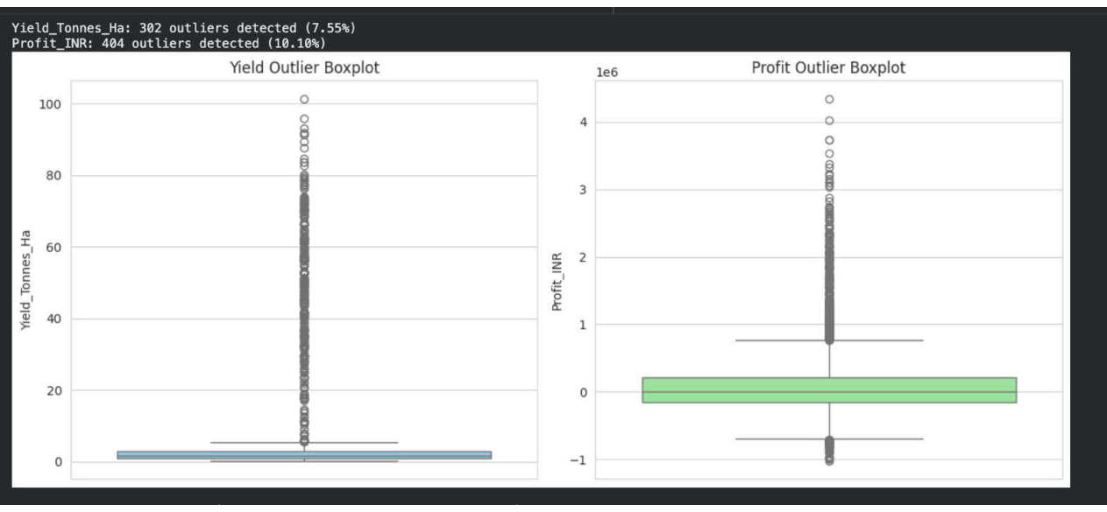
RESULTS — Outlier Analysis
Explanation
• Yield is concentrated at relatively low values, with many observations near the lower range.
• The yield boxplot shows numerous high-side outliers; 302 yield outliers are flagged (7.55%).
• Profit contains both positive and negative extremes, with 404 outliers flagged (10.10%).
• Extreme observations should be reviewed carefully because they may represent genuine high-performing or unusual farms.
01/08

Slide 7
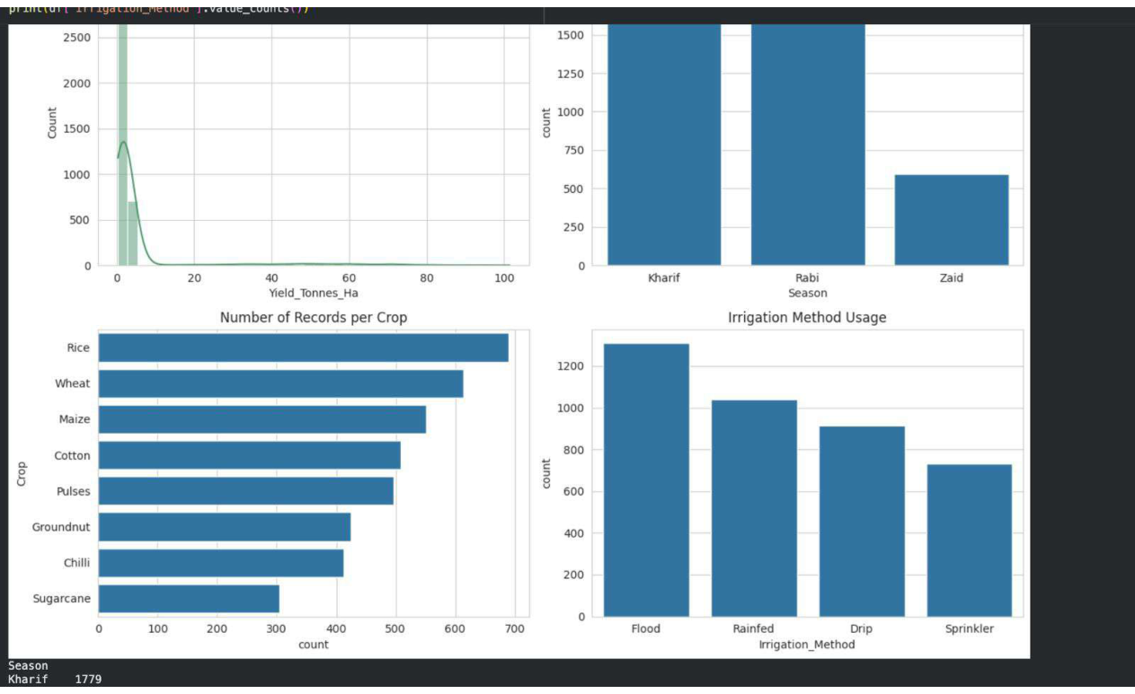
RESULTS — Distribution of Records
Explanation
• Yield is strongly right-skewed, with most observations at relatively low values and a small number of high-yield observations.
• Kharif and Rabi contain the largest numbers of records, while Zaid has substantially fewer observations.
• Rice has the highest number of crop records, followed by Wheat and Maize; Sugarcane has the fewest in the chart.
• Flood irrigation is most common, followed by Rainfed and Drip; Sprinkler has the lowest usage count.
02/08

Slide 8
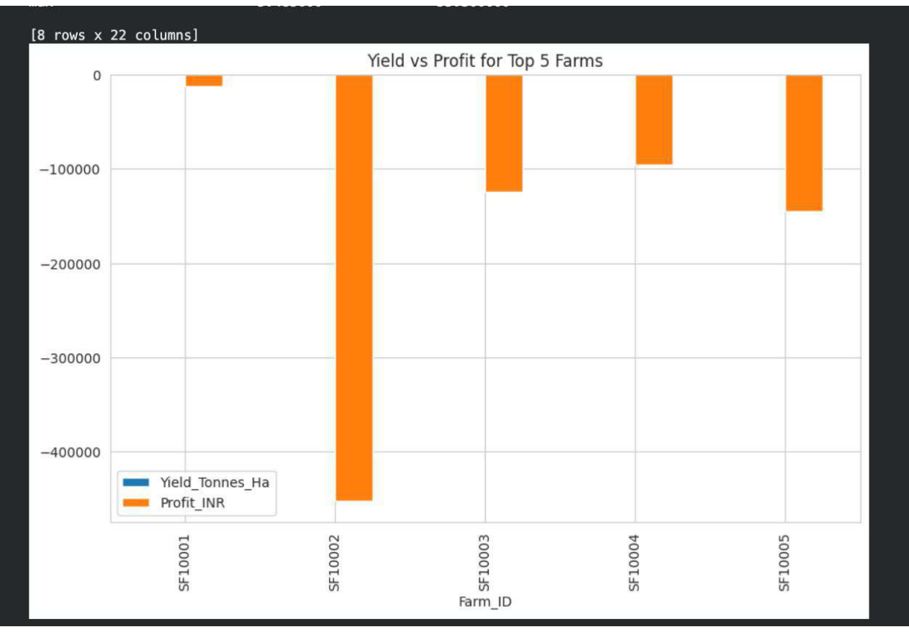
RESULTS — Yield vs Profit for Top 5 Farms
Explanation
• The chart compares yield and profit for the five farms with the largest observed values in the selected view.
• Yield and profit use very different scales, so their plotted magnitudes should be interpreted as separate measures.
• The comparison highlights how exceptional farm-level observations can dominate the overall range of the dataset.
• These extreme cases are useful for investigation before drawing general conclusions.
03/08

Slide 9
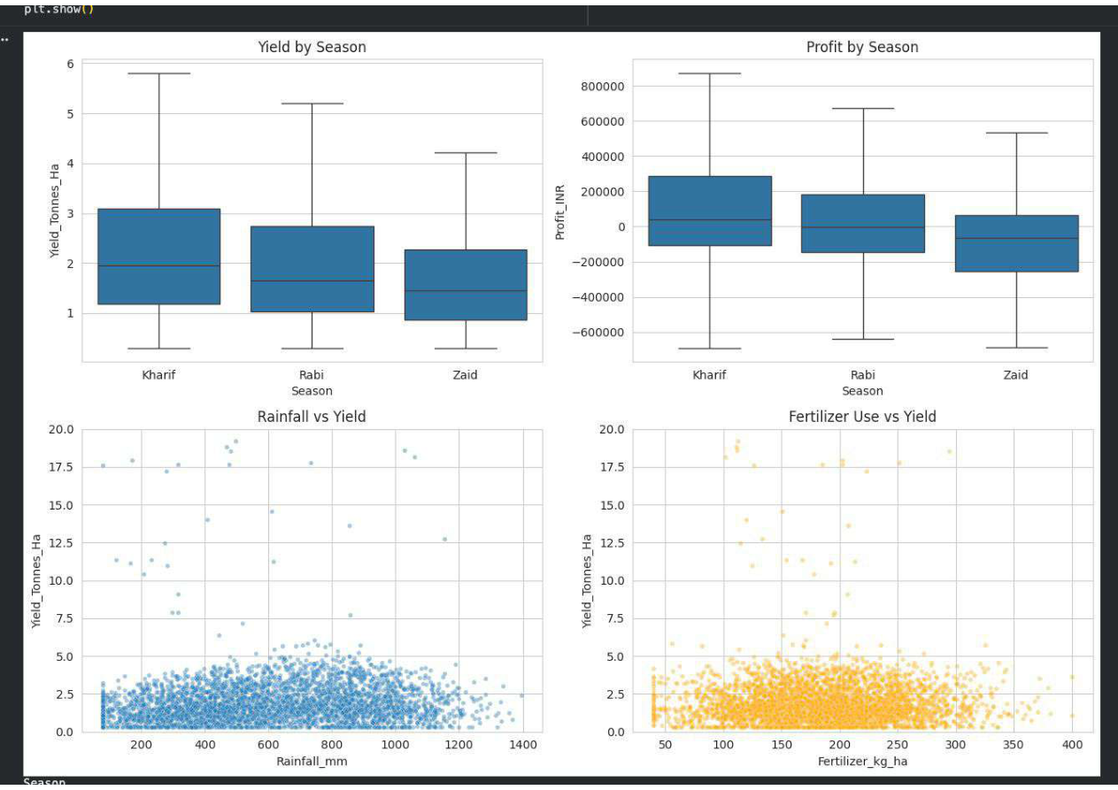
RESULTS — Seasonal Performance & Resource Relationships
Explanation
• Kharif has the highest median yield, followed by Rabi, while Zaid has the lowest median yield.
• Kharif also has the highest median profit; profitability varies considerably within all three seasons.
• The rainfall-versus-yield plot does not show a strong simple linear relationship; rainfall is not the only factor affecting yield.
• Fertilizer use also shows no strong simple linear relationship with yield, indicating the importance of other environmental and management factors.
04/08

Slide 10
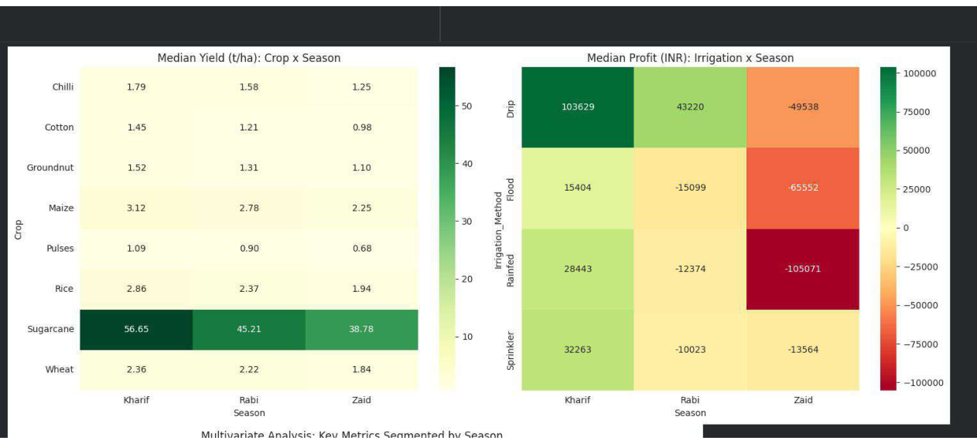
RESULTS — Crop & Irrigation Seasonal Analysis
Explanation
• The crop-by-season heatmap shows Sugarcane as a strong performer across all three seasons, with other crops showing smaller seasonal changes.
• Maize and Rice also maintain comparatively higher median yields than several crops in the table.
• Drip produces the strongest median profit in Kharif among the irrigation methods shown.
• Several irrigation methods show sharply lower profits in Zaid, demonstrating that irrigation performance depends strongly on season.
05/08

Slide 11
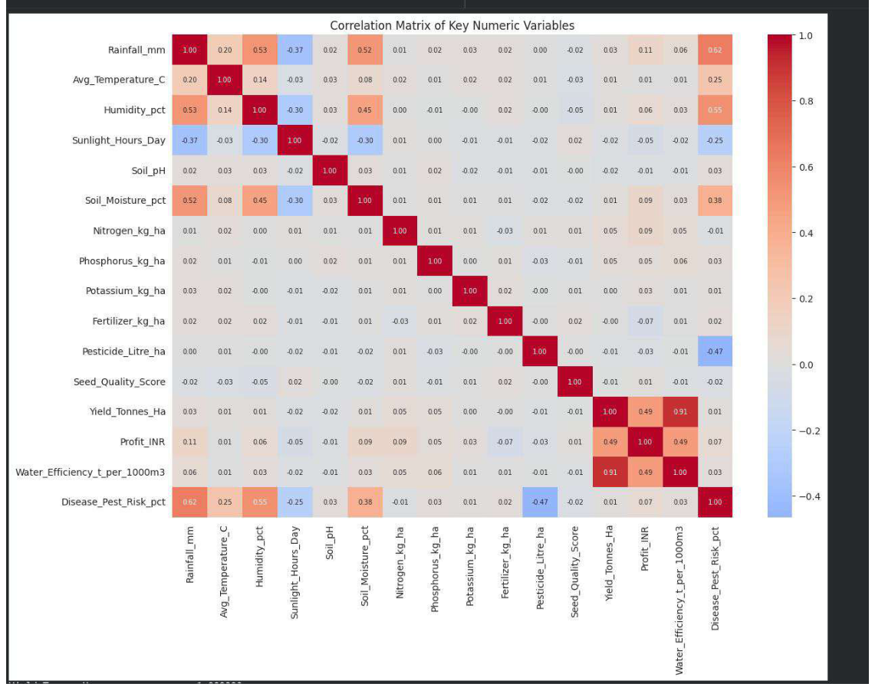
RESULTS — Correlation Matrix
Explanation
• The correlation matrix summarizes relationships among rainfall, temperature, sunlight, soil moisture, fertilizer, water usage, yield and profit variables.
• It helps identify numeric variables that move together and relationships that are comparatively weak.
• Correlation supports exploratory analysis and variable selection for deeper analysis or future modelling.
• Correlation alone does not establish causation.
06/08

Slide 12
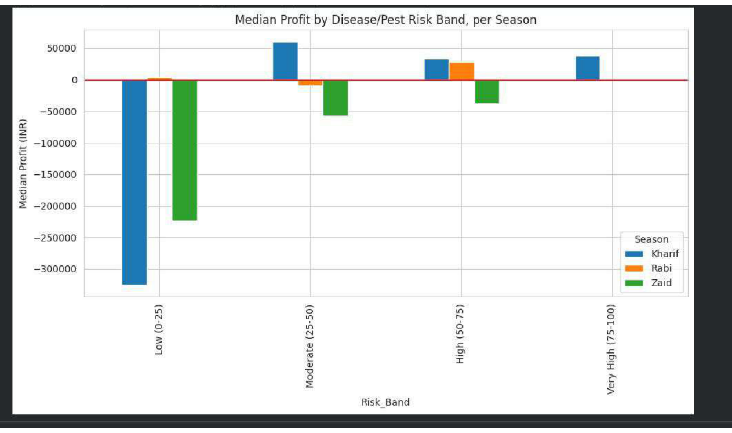
RESULTS — Disease/Pest Risk & Profit
Explanation
• Median profit varies substantially across disease and pest risk bands and across seasons.
• Kharif shows a very large negative median profit in the low-risk band in the displayed results.
• Zaid also shows negative median profit in several risk bands, while some Kharif and Rabi bands remain positive.
• The findings suggest that profitability and agricultural risk should be considered together.
07/08

Slide 13
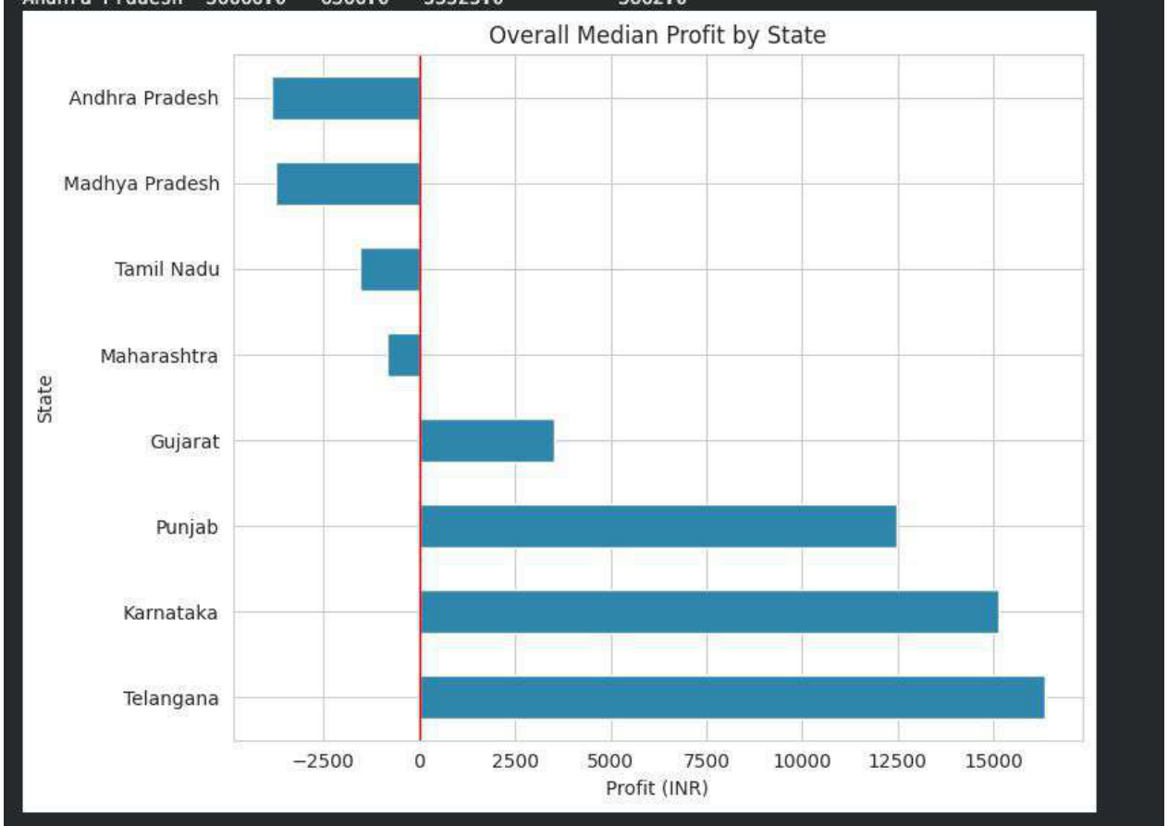
RESULTS — Regional Profitability
Explanation
• The regional comparison shows substantial differences in median profit across states.
• Telangana, Karnataka and Punjab are among the strongest positive-profit regions in the displayed results.
• Andhra Pradesh, Madhya Pradesh, Tamil Nadu and Maharashtra show negative median profit in the chart.
• Regional differences can guide further investigation into crop mix, costs, resources and local conditions.
08/08

Slide 14
Future Scope
• Extend the analysis with multi-year historical data to study long-term seasonal and climate trends.
• Add more granular weather, soil, pest and local market variables to reduce the impact of unmeasured confounding factors.
• Track dynamic market prices and input costs to study real-time profitability changes.
• Build predictive or decision-support models in a future phase, if required, using the insights established in this analytics project.
• Validate key findings with larger and more geographically diverse datasets.

Slide 15
GitHub Link
https://github.com/rajanaveenalajangi/-Seasonal-Agriculture-Performance-Analysis
The repository contains the project notebook and analysis workflow used for data preparation, exploratory analysis, visualization, insights and recommendations.

Slide 16

VOIS Course Completion Certificate — Data Visualization

Slide 17
Thank you
Seasonal Agriculture Performance Analysis
Alajangi Raja Naveen Naidu • Raghu Engineering College

